Slide 1
Courtroom Technology
U.S. Bankruptcy Court
Western District of North Carolina

Slide 2
Available Courtroom Technology
 | C1-4 | C1-5 | Statesville | Asheville | Shelby
Computer/Tablet Connections | yes | yes | yes | yes | no
Evidence Presentation | yes | yes | yes | no | no
Teleconference | yes | yes | yes | yes | no
Video Conference | yes | yes | yes | yes | no
Annotation | yes | yes | yes | no | no
Witness Monitor | yes | yes | yes | yes | no
Large Monitor on Wall | yes | yes | yes | yes | no
Attorney Table Monitor | yes | yes | yes | yes | no
Wireless Internet | yes | yes | yes | yes | no
Listening System for Hearing Impaired | yes | yes | yes | yes | no

Slide 3
Lead Time for use of technology
Telephone Conferencing
Permission Required
24 Hour Minimum Is Required
Video Conferencing
Permission Required
72 Hour Minimum Is Required
Test Connection Is Required
Evidence Presentation
Permission Required
48 Hour Minimum Is Required
Schedule a time to test your equipment prior to court date to ensure it work with courtroom technology
Notes:
CHARLOTTE ONLY: To further our point on when you should contact chambers: appearing via telephone has to be approved by the Judges. Remember that if it’s an evidentiary hearing, or a witness is involved, both parties must be present in court. You will not be allowed to depose a witness via conference call. We ask that at a minimum, you should contact Chambers at least 24 hours ahead of time. The same goes for Asheville, permission is required. Also note that we do not have the same equipment in Asheville, so our capability is limited there. However you have been doing it in Asheville, will continue.
Video Conf. is available in Charlotte, but there are certain pre-requisites that have to be met. 1. At a minimum, you must contact Chambers 3 days in advance or your hearing to get permission from the Judges to use this technology. The larger the lead time on this the better for you. Tests have to be performed, our Court also has to check with District Court for any conflicts with this equipment.
Evidence presentation equipment is available at our Courthouse in Charlotte, but you still need to get permission to use the equipment in Court. Please know that yes you do have to ask permission every time, because our Judges want to make sure it makes sense, and it’s fair to both sides of the table. Both Judges have embraced this technology and they understand the

Slide 4
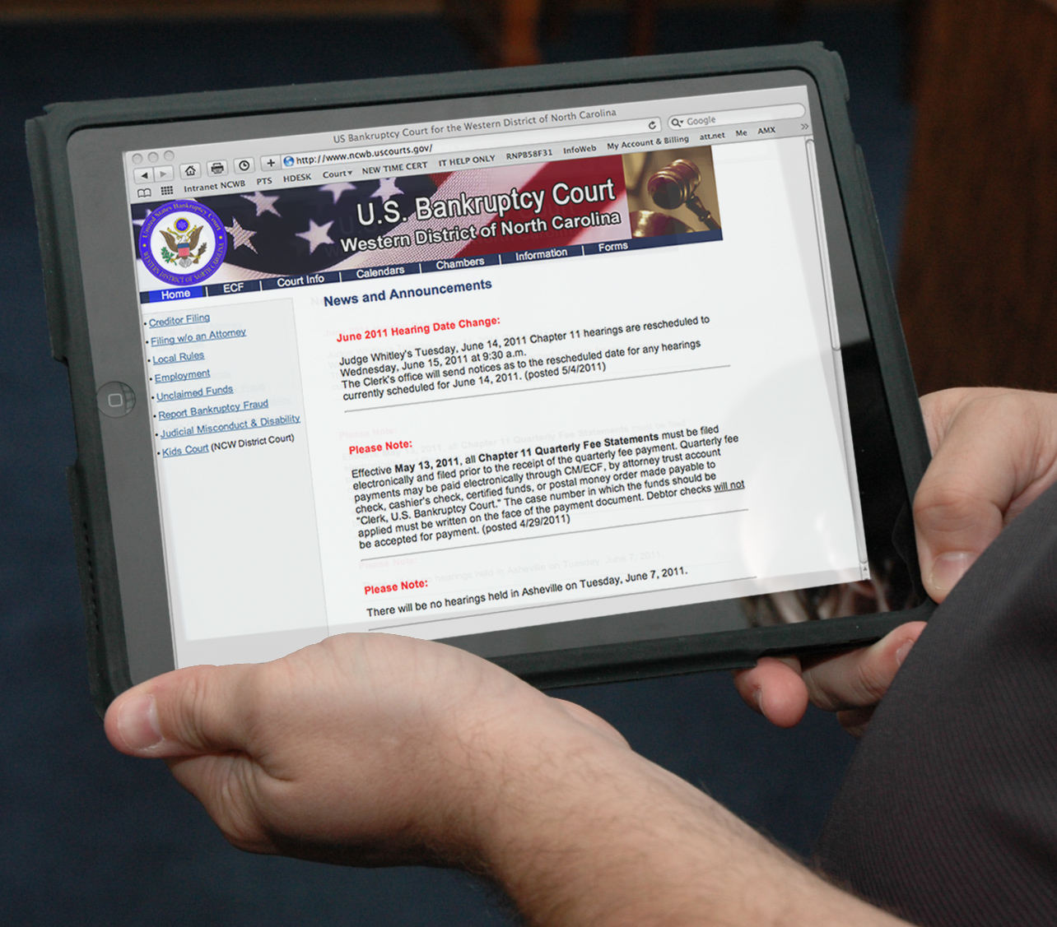
Computers In Court
Computers are Allowed
“Attorney_Net” is Court’s Free Wireless Network (Charlotte , Statesville & Asheville)
Notes:
The Bankruptcy Court has allowed the use of laptops in the courtroom for a couple of years now. I have spoken with Court Security here in Charlotte, and they have assured me that they have been allowing attorneys and their paralegals to bring in laptops to court. IN CHARLOTTE & ASHEVILLE, we have a wireless Internet connection called “AttorneyNet” that is open to the public. The hotspot is available to attorneys who need perform official business while attending a hearing. It is not meant to allow you to update your facebook page or “Tweet” your location. (Charlotte & Asheville Only)

Slide 5
Computer/Tablet
Connection requires standard VGA or HDMI connection
Standard Audio Port Available (3.5mm connector)
Court will not supply adapters to connect to VGA or HDMI

Slide 6
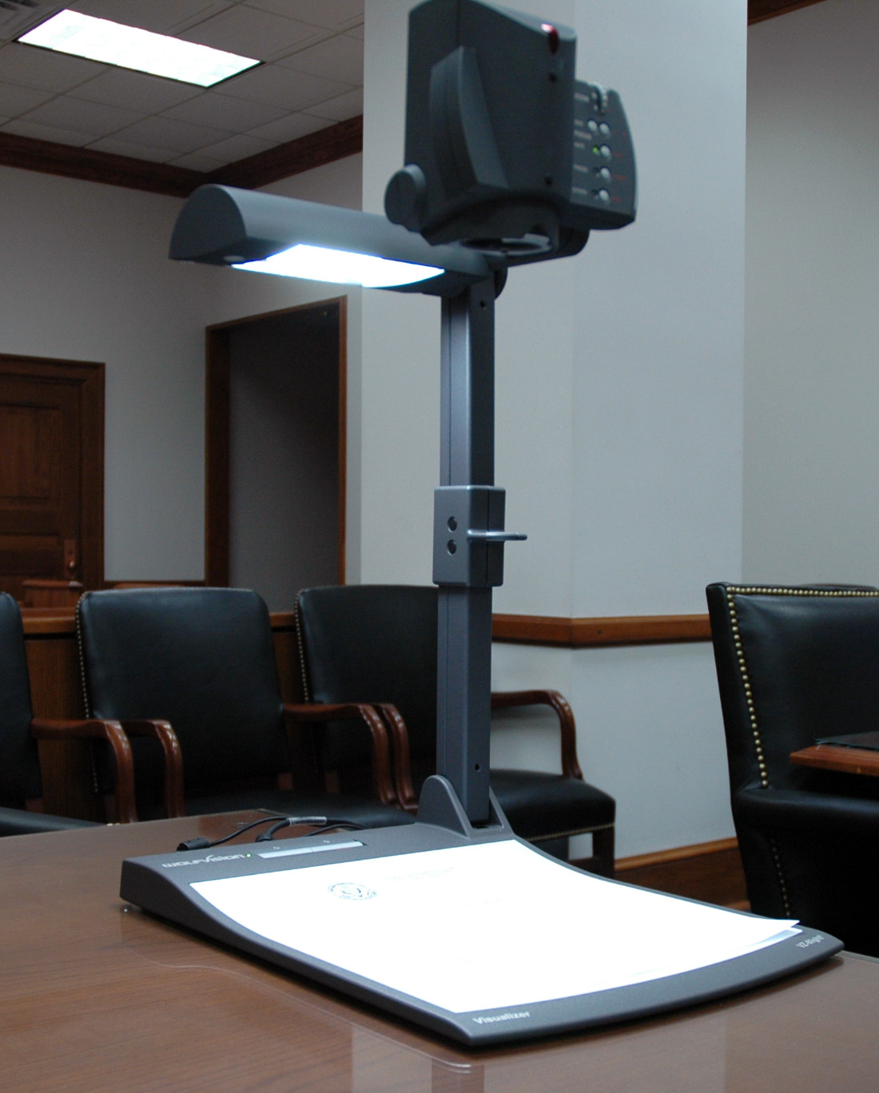
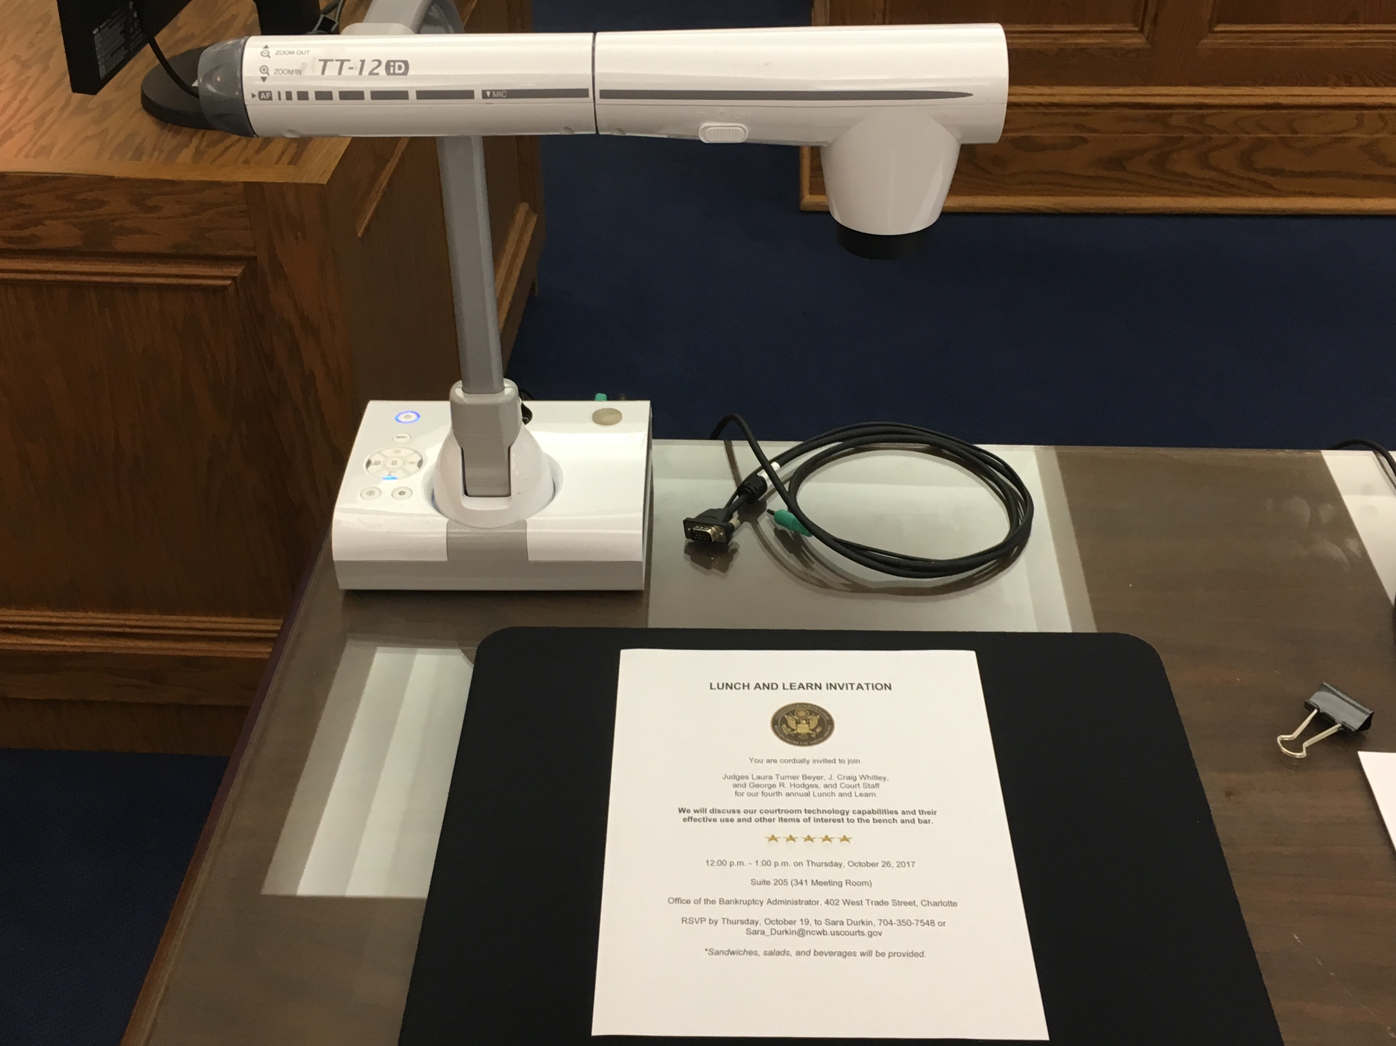
Evidence Presentation
Document Viewing
Capable of Zooming in and out

Slide 7
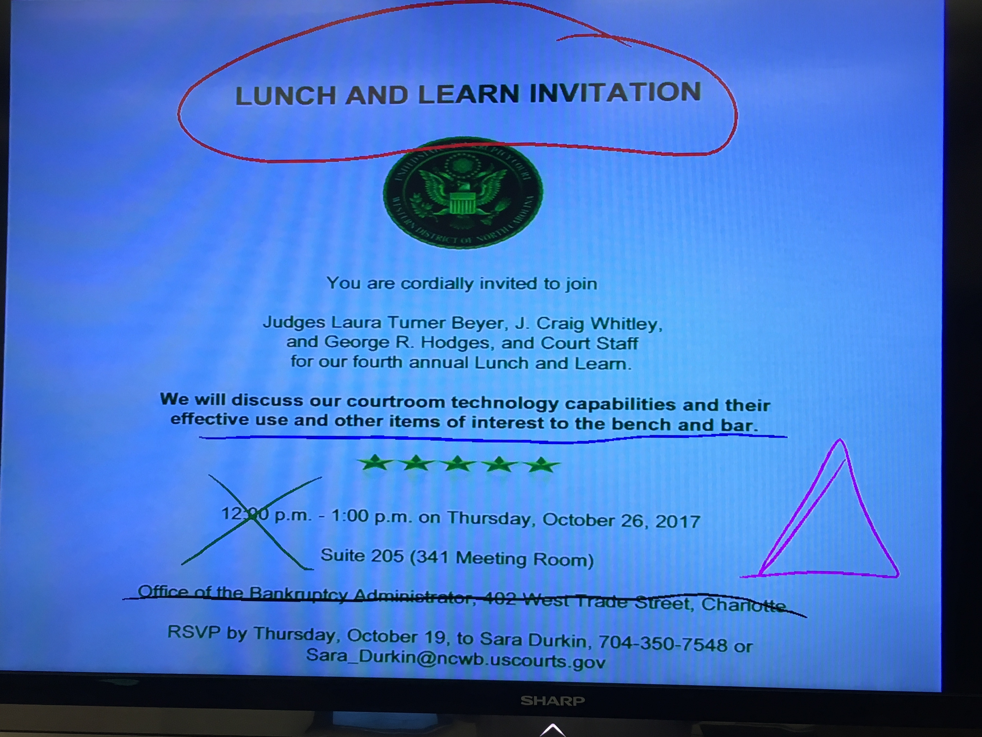
Annotation
Choose line colors
Choose line thickness
Can be seen on all monitors
Can be used at Attorney and Witness monitors

Slide 8
Telephone Conferencing
Permission is Required
Chambers will issue Phone number, Conference ID Number & Security Code
Call in 15 Minutes BEFORE Court begins for the day (not when your case begins)
Place your phone on mute when not speaking
Stay on the line until Court completes, or ask permission to disconnect
Headsets and Speakerphones are not recommended as they can distort audio.
Notes:
CHARLOTTE INFORMATION ONLY…
We share these phone lines with District Court.

Slide 9
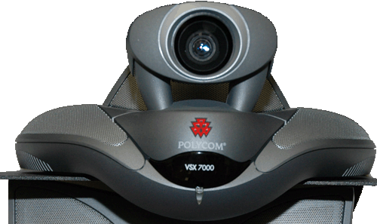
Video Conferencing
Case by Case basis with Judge’s Approval
Minimum 72 hour lead time need to:
Attorney: Receive Court’s Permission
Attorney: Provides Court with their connection information
Court: Will test the connection with attorney’s system 24-48 hours before
Attorney: Other arrangements will be necessary, if testing does not meet Court’s requirements
Notes:
Video Conf. is pointless if you cannot hear the Judge, or we cannot hear or see you. High Speed Internet connection is the real KEY.

Slide 10
Local Rule 9029-1 Telephonic and/or Video Appearance at Hearings
(a) Consent. Counsel who are unable to attend hearings in person may appear before the Court by telephonic and/or video appearance only with the consent of the Court and opposing counsel and provided that arrangements are made in advance.
(b) Arrangements. The attorney requesting permission to appear by telephonic and/or video shall make all necessary arrangements with the judge’s chambers and shall initiate the contact. The Court may set a time certain for any telephonic and/or video appearance hearing requested so as to avoid delaying other matters on the hearing calendar.
(c) Assumption of Risk. The risk of poor reception or other problems is borne by the attorney requesting and initiating the telephonic and/or video appearance.
(d) Limits on Availability. Not all divisional offices support telephonic appearances. Refer to the Court’s website (www.ncwb.uscourts.gov) for availability.
(e) Evidentiary Hearings. Telephonic and/or video appearances are not allowed in evidentiary hearings.
(f) Telephonic and/or Video Appearances at Hearings Before the Judge. Counsel who wish to appear by telephonic or video means in any Court hearing must follow and comply with the applicable rules for such appearances as may be posted on the Court’s website (www.ncwb.uscourts.gov).

Slide 11
Reminders from the Chief Judge
Remember your phone manners - your convenience should not negatively affect Court
Telephonic appearance are for Attorneys only
If you are an Attorney in the courtroom remember to step up and speak into a microphone so everyone on the phone can hear you
Notes:
Do not assume appearing telephonically will put you at the front of the line. If your not on the phone by the time court starts you may be out of luck.

Slide 12
Timothy Lamb
Courtroom Technology Administrator
704-350-7500

