Slide 1
Courtroom Technology
U.S. Bankruptcy Court
Western District of North Carolina
Revised 3/17/25

Slide 2
Available Courtroom Technology
 | C2-A | C2-B | Statesville | Asheville | Shelby
Computer/Tablet Connections | yes | yes | yes | yes | no
Evidence Presentation | yes | yes | yes | yes | no
Teleconference | yes | yes | yes | yes | no
Video Conference | yes | yes | yes | yes | no
Annotation | yes | yes | yes | yes | no
Witness Monitor | yes | yes | yes | yes | no
Large Monitor on Wall | yes | yes | yes | yes | no
Attorney Table Monitor | yes | yes | yes | yes | no
Wireless Internet | yes | yes | yes | yes | no

Slide 3
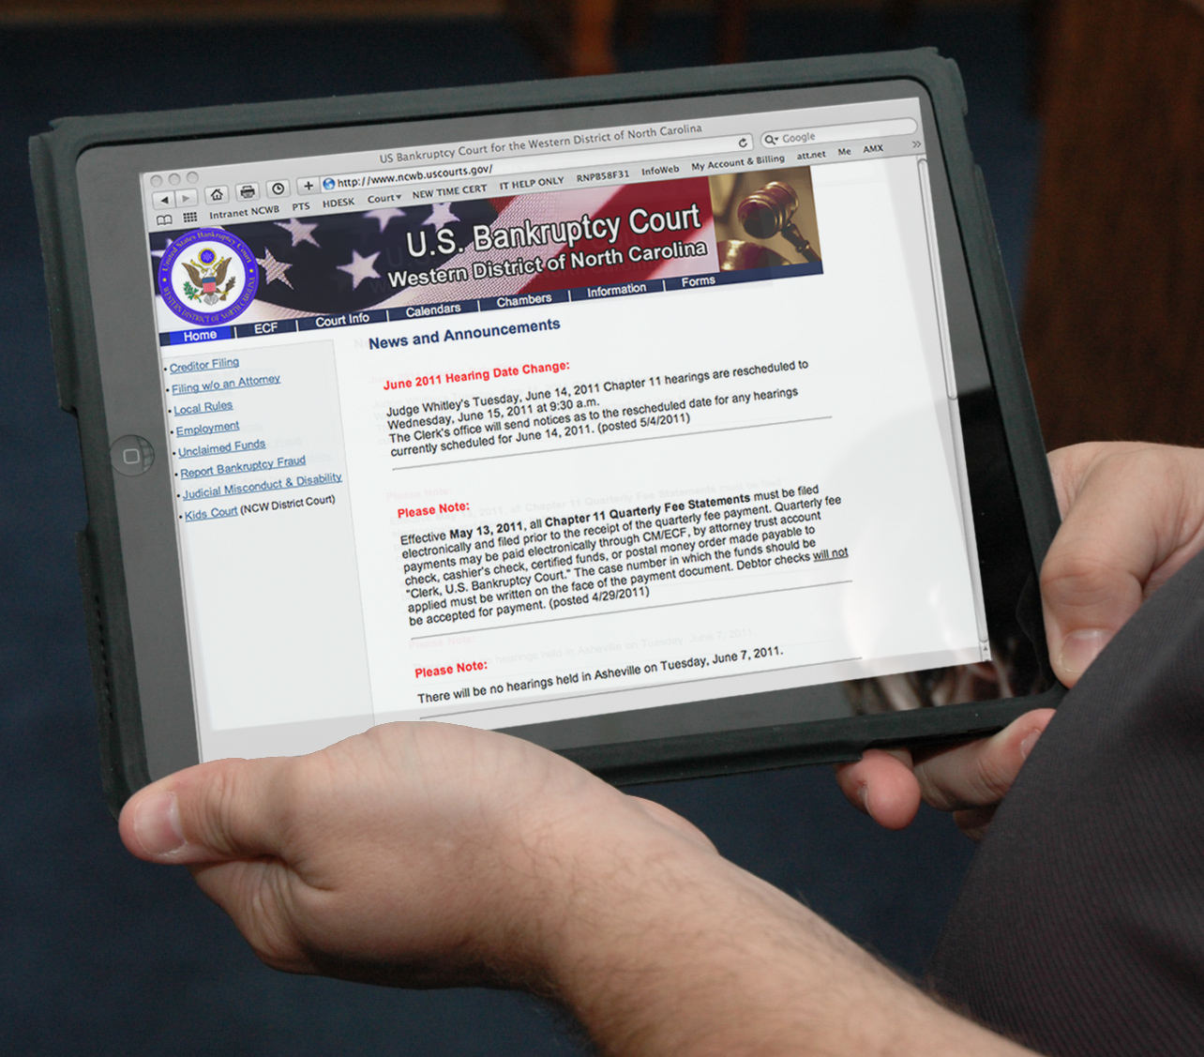
Computers In Court
Computers are Allowed
“Atty_Net” is Court’s Free Wireless Network Charlotte, Statesville and Asheville
Notes:
The Bankruptcy Court has allowed the use of laptops in the courtroom for a couple of years now. I have spoken with Court Security here in Charlotte, and they have assured me that they have been allowing attorneys and their paralegals to bring in laptops to court. IN CHARLOTTE & ASHEVILLE, we have a wireless Internet connection called “AttorneyNet” that is open to the public. The hotspot is available to attorneys who need perform official business while attending a hearing. It is not meant to allow you to update your facebook page or “Tweet” your location. (Charlotte & Asheville Only)

Slide 4
Computer/Tablet
Connection requires standard VGA, HDMI or USB-C connection
Standard Audio Port Available (3.5mm connector)
Court will supply most commonly used adapters to connect to HDMI. (contact Court for information)

Slide 5
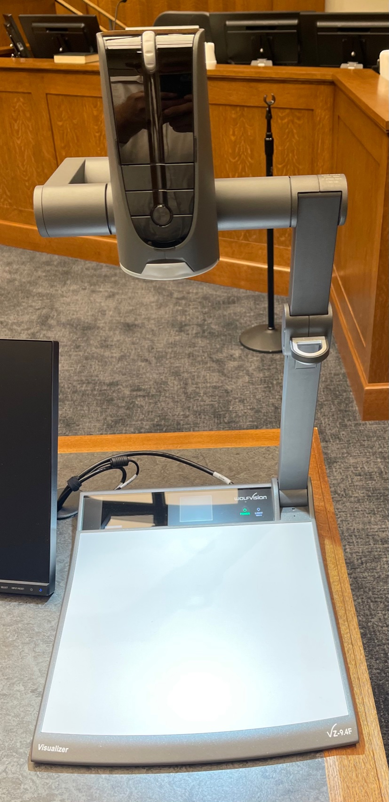
Evidence Presentation
Document Viewing
Capable of Zooming in and out

Slide 6
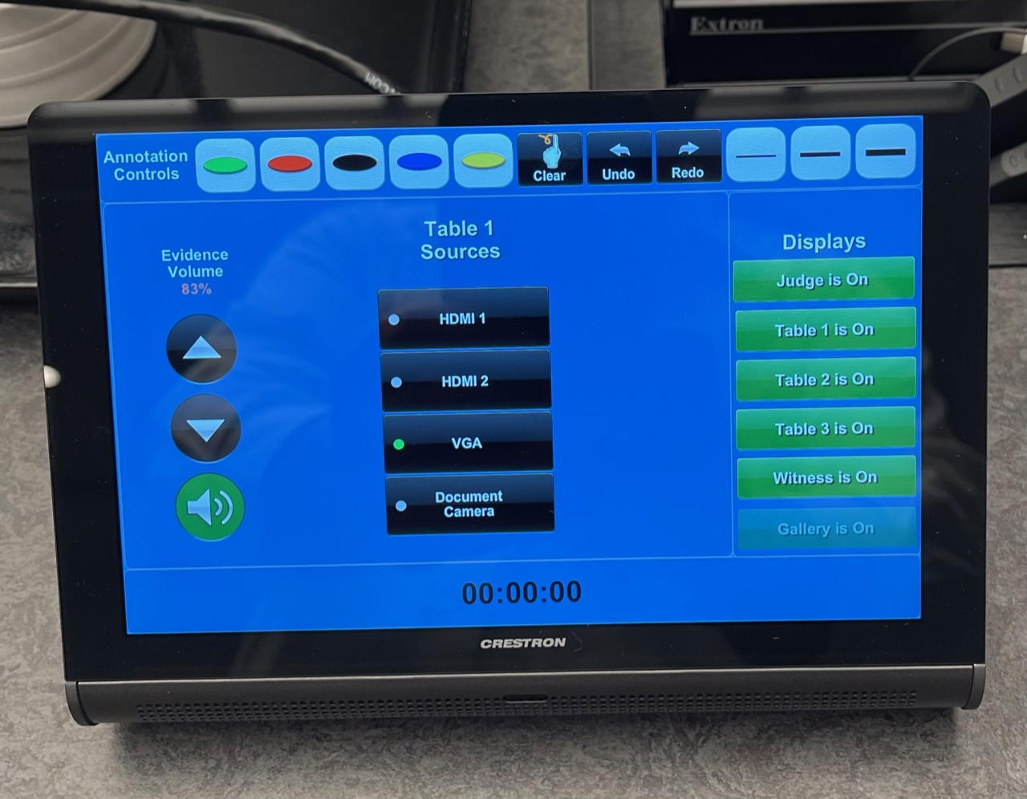
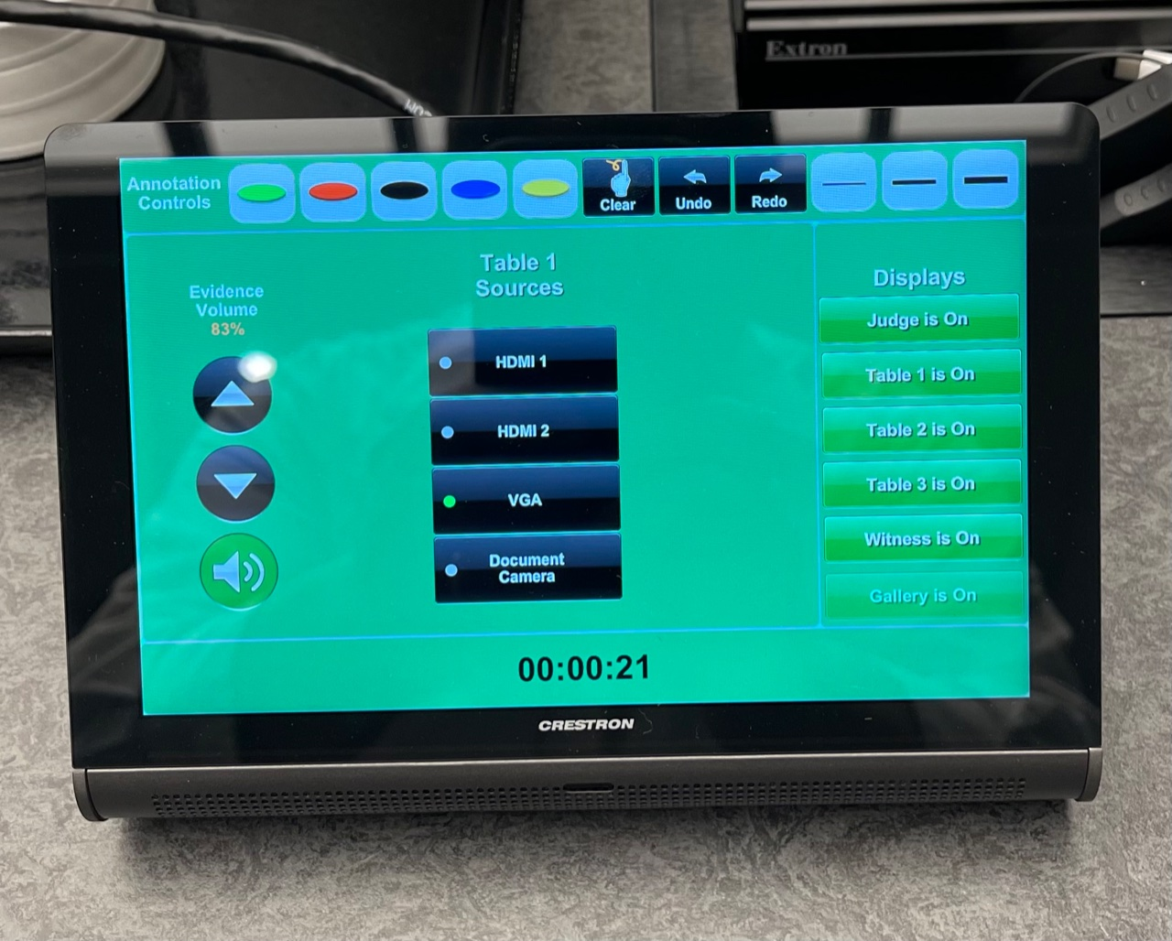
Control Panel
Allows to choose between HDMI,VGA and Document Camera
Controls annotation
Has a built in Timer
Chooses where to route sources to

Slide 7
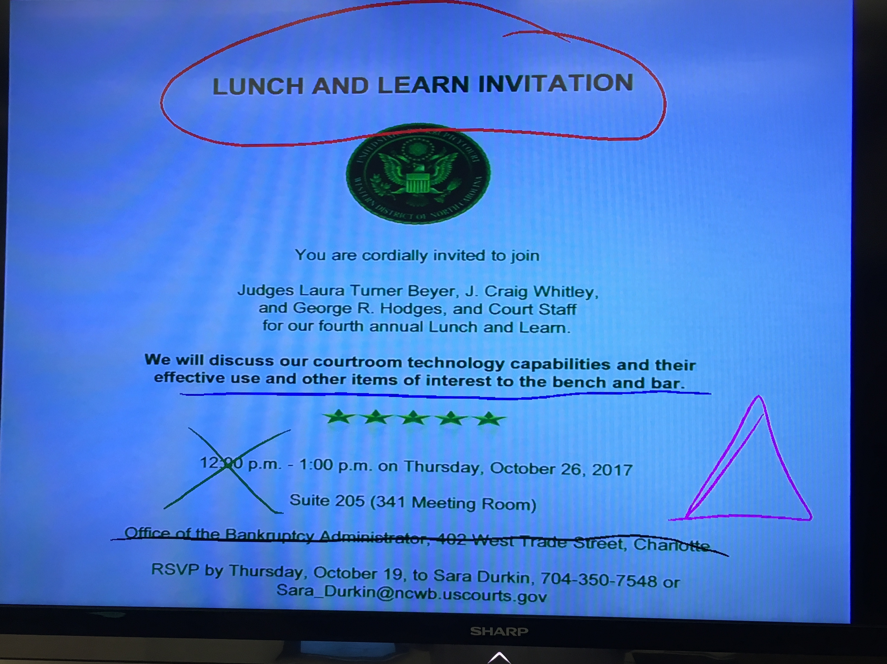
Annotation
Attorney Tables and Witness Stand
Choose colors
Choose line thickness
Highlight/Spotlight
Can be seen on all monitors

Slide 8
Telephone Conferencing
Permission from Chambers is Required
Chambers will issue Phone number and Conference ID Number
Call in15 Minutes BEFORE Court begins for the day (not when your case begins)
Place your phone on mute when not speaking using *6
Stay on the line until Court completes, or ask permission to disconnect
Headsets and Speakerphones are not recommended as they can distort audio. Avoid CELLPHONES on conference calls
Notes:
CHARLOTTE INFORMATION ONLY…
We share these phone lines with District Court.

Slide 9
Teams Video conference
Permission from Chambers is Required
Everyone required to Test at least 48 Hours Prior to hearing this includes Witnesses
(Contact IT to set up Test)
Call in 15-20 Minutes BEFORE Court begins for the day to do final audio/video check
Mute microphone and turn off camera when not speaking
Dress and act as if you are in the courtroom

Slide 10
Reminders from the Chief Judge
Remember your manners - your convenience should not negatively affect Court
If it’s an evidentiary hearing, you need to physically be in Court
No one appearing telephonically will be allowed to present or depose a witness
Telephonic appearance are for members of the bar only
Notes:
Do not assume appearing telephonically will put you at the front of the line. If your not on the phone by the time court starts you may be out of luck.

